Slide 1
What is Design?
Programming Usable Interfaces (PUI)
05-430 / 05-630 Fall 2018
Jason Hong
jasonh@cs.cmu.edu
Notes:
Reminder: No laptops in class
Video to preload: https://www.youtube.com/watch?v=aXV-yaFmQNk

Slide 2
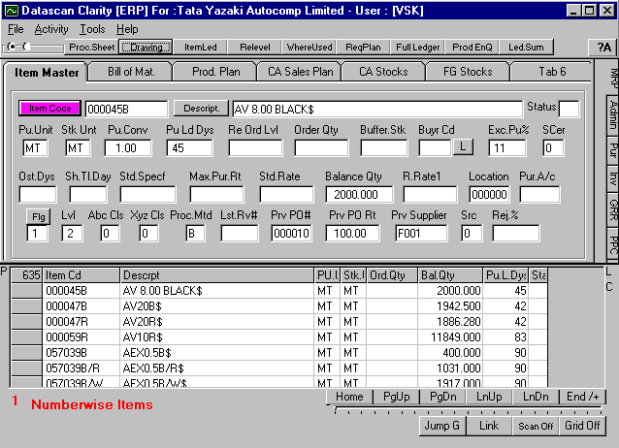
UI Hall of Fame or Shame?
Notes:
Lack of aesthetics
Lack of flow
Poor layout
Hard to tell what is important and what is not

Slide 3
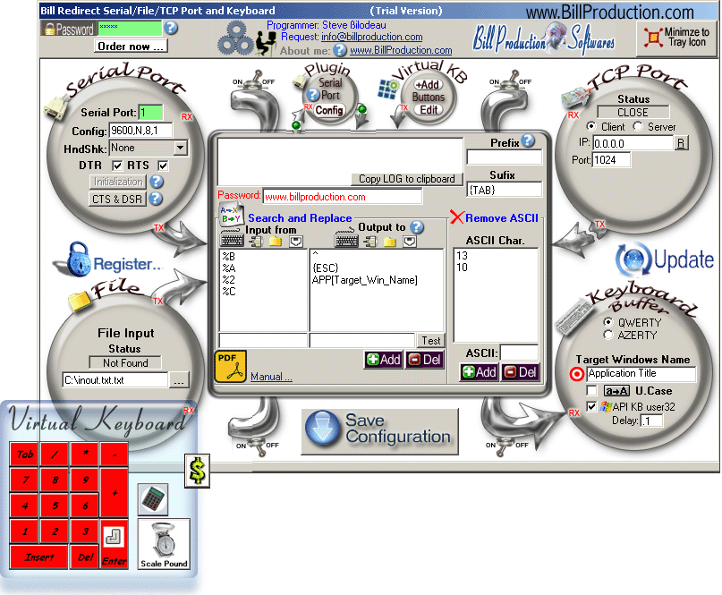
UI Hall of Fame or Shame?
Notes:
Lack of aesthetics
Lots of excess in the image, hard to see what’s important

Slide 4
Design Principles
Aesthetic Design
Flow (often left-to-right)
Starting point
Where does eye go first?
Can’t differentiate important from not
Layout
Should fit a grid (more on this later)

Slide 5
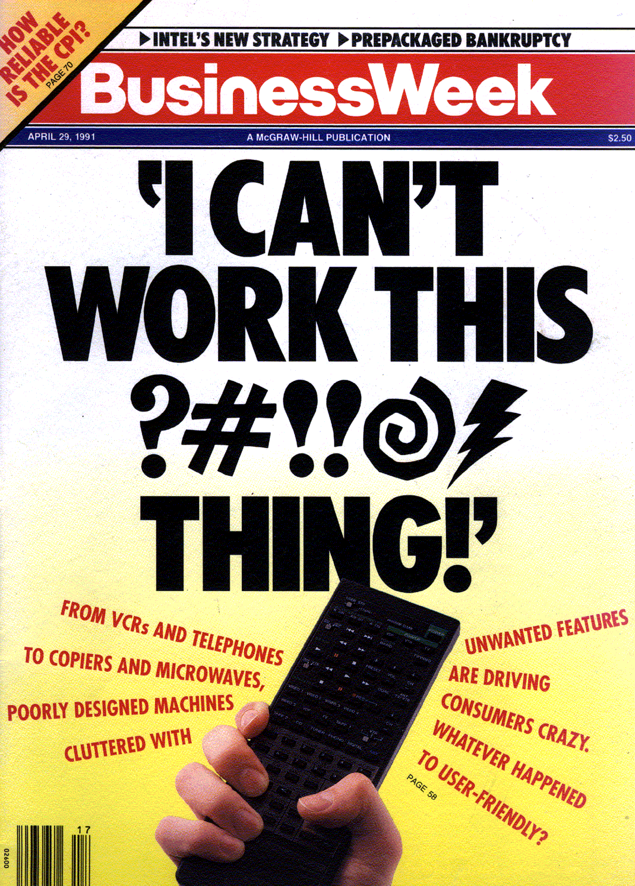
Why is Good Design Important?
Major part of work for systems
~50% implementation
Bad user interfaces cost:
Money (rework, helpdesk)
Reputation of organization (e.g., brand loyalty, trust)
Time (wasted effort, wasted energy)
Security (Congressional file server)
Lives (Therac-25)
Notes:
Studies have shown that the design, programming, and evaluation of the UI can take up to 50% of the project time and cost for a wide range of commercial and in-house software
Nearly 25% of all applications projects fail. Why?
overrun budgets & management pulls plug
others complete, but are too hard to learn/use
Solution is user-centered design. Why?
easier to learn & use products sell better
can help keep a product on schedule
finding problems early makes them easier to fix!
training costs reduced

Slide 6
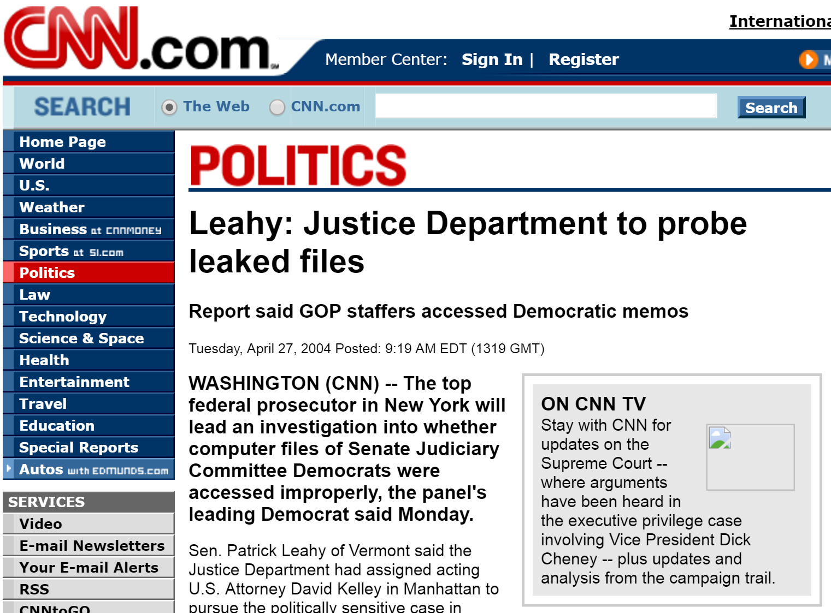
Notes:
User interface problem, the admin misconfigured access control, and Republicans could access all Democrat files. And they did. Big user interface problem in windows, hard to understand.
See Rob Reeder’s dissertation for more detail and examples.

Slide 7
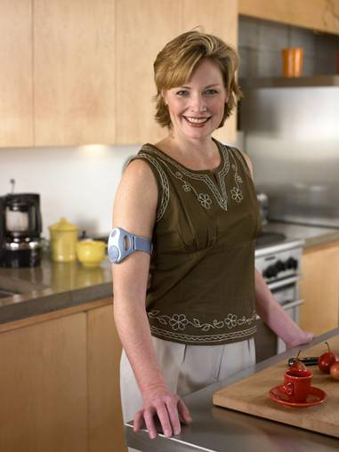
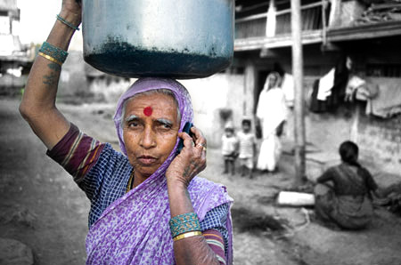
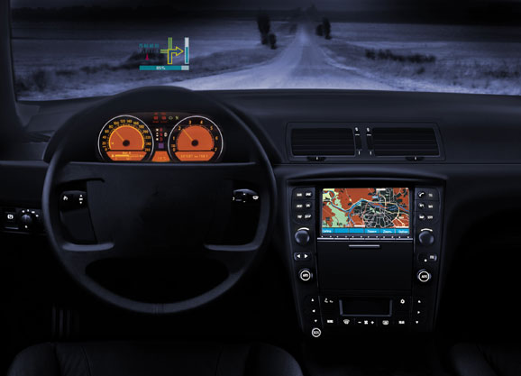
Why is Good Design Important?
Computing now touches every part of life
Great UX design now a differentiating factor
Great UX design also essential for reliability, security
Great UX design is only way we can achieve full potential of computing
Notes:
But HCI isn’t just about avoiding the bad
Only way we can achieve full potential of computing is if people can understand it, feel empowered

Slide 8
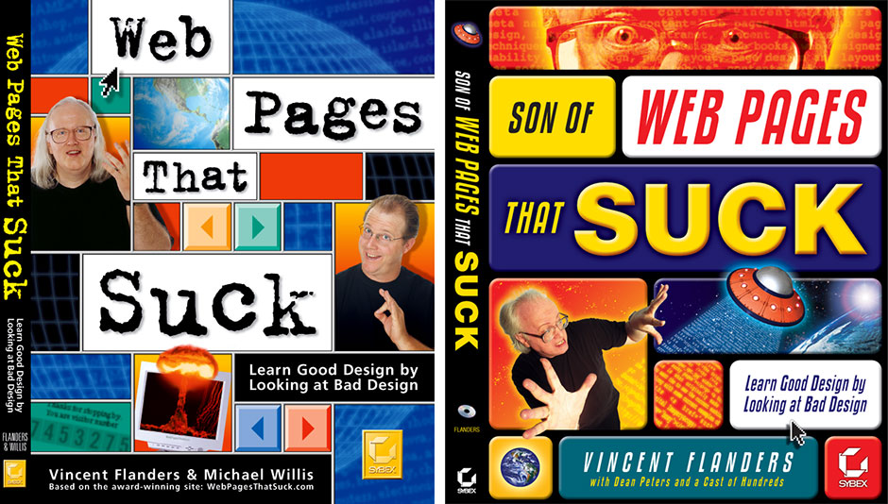
Lots of Examples of Bad Design
Notes:
Lots of examples of bad
And we’ll go thru lots of these
But we also need to study good designs too

Slide 9
Examples of Good Designs?
What do you think are examples of good designs?
Starbucks app (previous orders, mobile payment)
Input date (calendar widgets) or text input
iOS welcome and setup screen
Kleenex tissues, don’t need to touch box
Apple Pay and Google Pay
And what kinds of common characteristics?
Notes:
Google search bar
Simple and easy to use
iPad
No manual, 4yo can use it
OneNote
Really easy
Microsoft Office 2010
Ribbon, lots of space vs toolbars
Chrome

Slide 10
Common Characteristics?
Clear every semester
Notes:
Google search bar
Simple and easy to use
iPad
No manual, 4yo can use it
OneNote
Really easy
Microsoft Office 2010
Ribbon, lots of space vs toolbars
Chrome

Slide 11
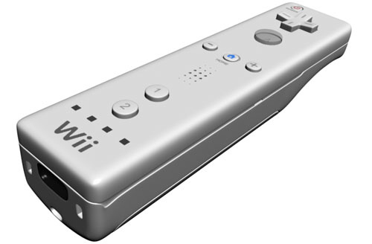
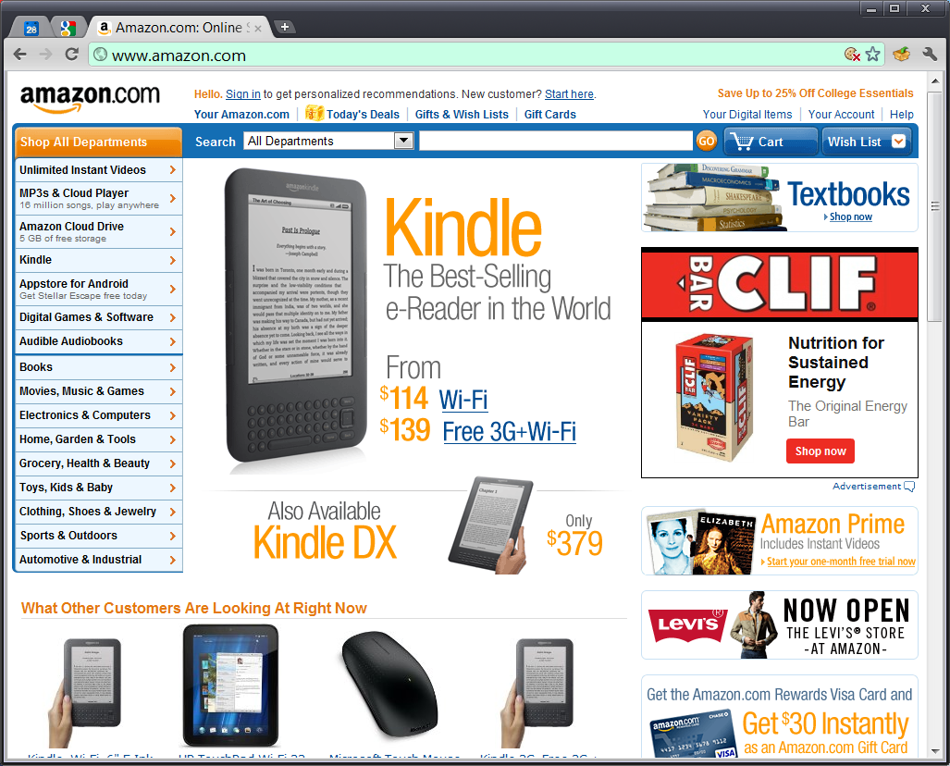
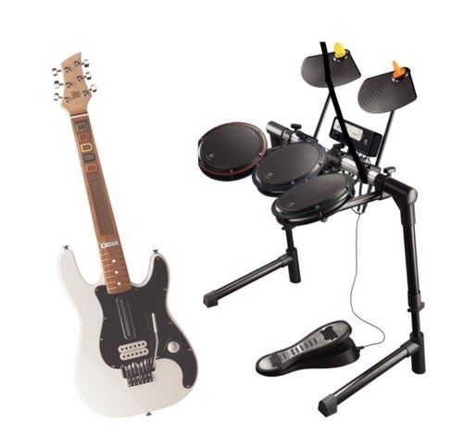
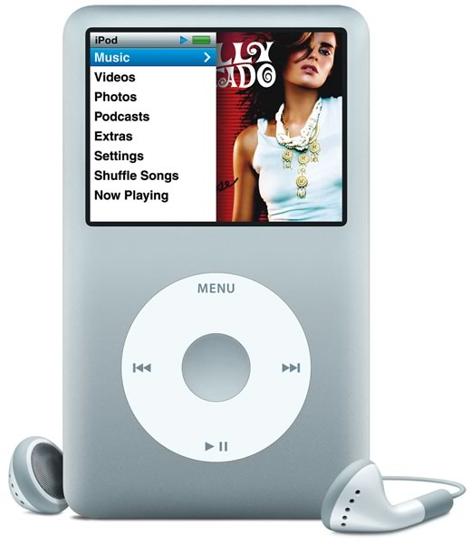
My Examples of Good Designs
Some easy choices
Notes:
Engaging
Solves problems well / fits well within one’s life
Aesthetic
Approachable

Slide 12
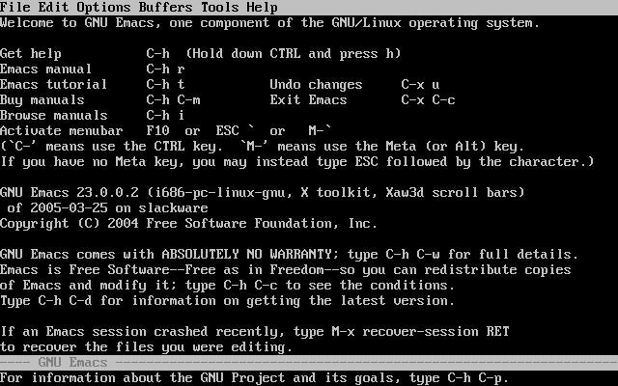
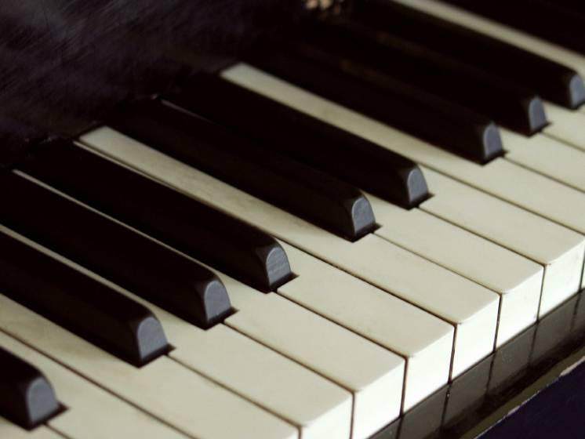
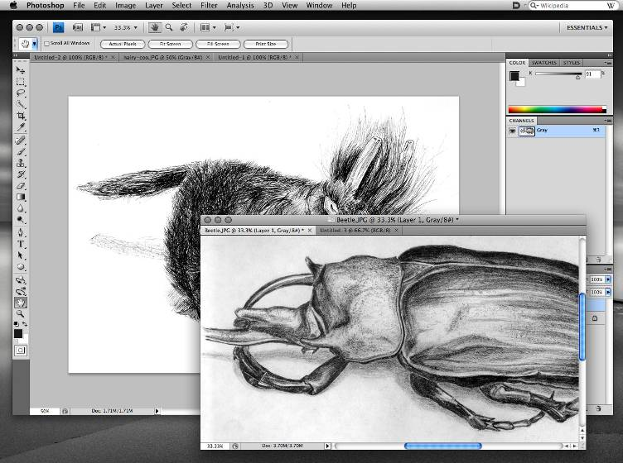
My Examples of Good Designs
Some not so obvious choices:
Unix
Emacs
Adobe Photoshop
Piano
Notes:
Allows for high skill and high performance
Unix: Solves problem very well (40+ years, still in use)
Adaptable for new situations and needs

Slide 13
Some Common Characteristics
Characteristics of Good Designs
Aesthetic / emotional connection
Allows for high performance
Learnable
Fun
Has a strong and clear value proposition
…so, the answer is that it really depends
Common themes
Solves a problem within a set of constraints well
Useful, usable, desirable

Slide 14
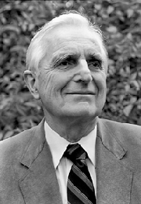
Good Design more than Usability
Common misconception is that all designs need to be “intuitive” or walk up and use
“If ease of use was the only valid criterion, people would stick to tricycles and never try bicycles.”
Doug Engelbart
Notes:
Unix is not easy to use, but offers a lot of value and high performance for experts

Slide 15
Outline for Today
What is Design?
Myths about Design
Why is Good Design so hard?
Processes
Usability Goals and Metrics
Mindset for Good Design
High level overview of how parts fit together

Slide 16
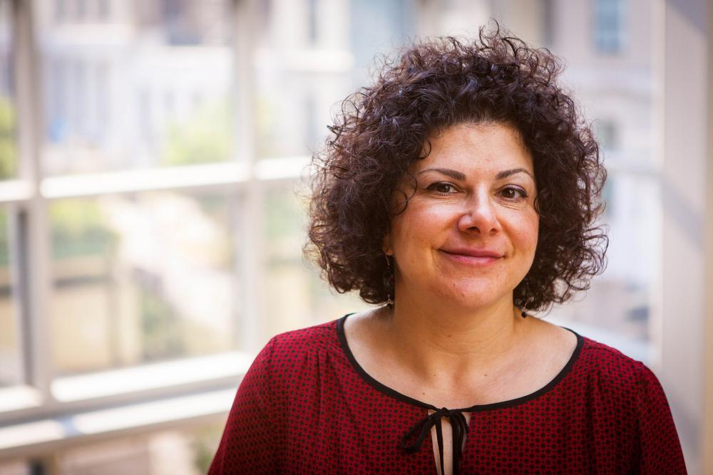
What is Design?
“The human power of conceiving, planning and making all the products that serve human beings in the accomplishment of their individual and collective purposes.”
Jodi Forlizzi

Slide 17
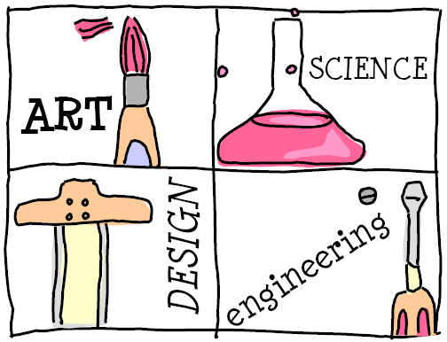
Notes:
From Rich Gold’s Plenitude
Difference between art and design: an artist will create something, a designer will turn it around and say “Do you like it? I’ll change it if you want”
Some people confuse Art and Design.
Rich Gold argues that Art is actually closer to Science, in that both are seeking Truth in their own way
Similarly, Design is closer to Engineering, in that both are seeking to create things for others.
Rich has a funny way of describing Art vs Design. An artist will create something. A designer will turn it around and say “Do you like it? I’ll change it if you want.”
So Design is more about solving problems that people have.

Slide 18
Myths about Good UX Design
Myth 1: Good design is just cool graphics
Graphics part of bigger picture of what to communicate and how
Also need to consider what people are trying to do and how to improve
Myth 2: Good design is just common sense
Why are there so many bad web sites? So many hard to use apps?
Underestimates work needed for great UX

Slide 19
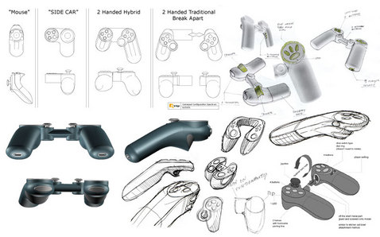
Early Nintendo Wii Prototypes
Notes:
Nintendo tried LOTS of ideas.
Three important takeaways here.
First, these prototypes took a lot of work to come up with and sketch out.
Second, look at the breadth of ideas in the early stages. This broad exploration is important in early stages.
Third, note that they tried sketches first, that is quick, cheap, and dirty.

Slide 20
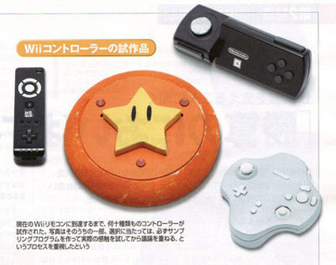
Early Nintendo Wii Prototypes
Notes:
Later on, they transitioned to physical prototypes. Still, look at the breadth of ideas.
I’m not sure how that Star controller would have worked, but have to admit it looks pretty cool.

Slide 21
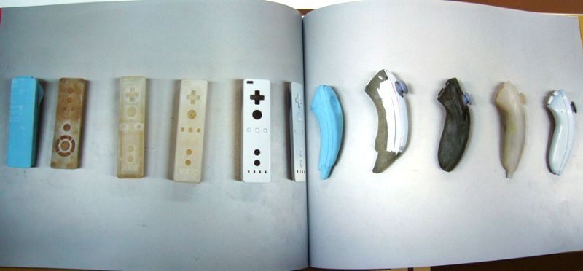
Early Nintendo Wii Prototypes
Notes:
And now we get close to the design we are familiar with today.
Note that they start with foam core, then what might be wood or rubber, then plastic, then the final polished version. So there’s iterative refinement even when you have the basic core idea.
These prototypes also took a lot of work!

Slide 22
Myths about Good UX Design
Myth 3: We can fix the interface at the end
Overlooks cost of major changes
“A common rule we should always try to heed is to detect and fix any problem in a production process at the lowest-value stage possible”
Andy Grove (Intel employee #1 and former CEO)
Also, good design includes making sure you have the right features (it’s not just about usability)
Understand people’s needs and addressing those

Slide 23
Myths about Good Design
Myth 4: Marketing takes care of understanding customer needs
Does not help you understand behavior
Gap between what people say vs. what they do and what they actually need

Slide 24
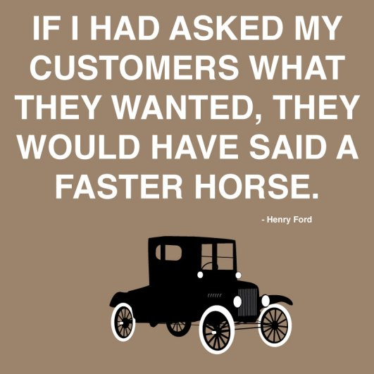
Famous Quotes on Marketing
Notes:
If I had asked people what they wanted, they would have said faster horses
Henry Ford (apocryphal)

Slide 25
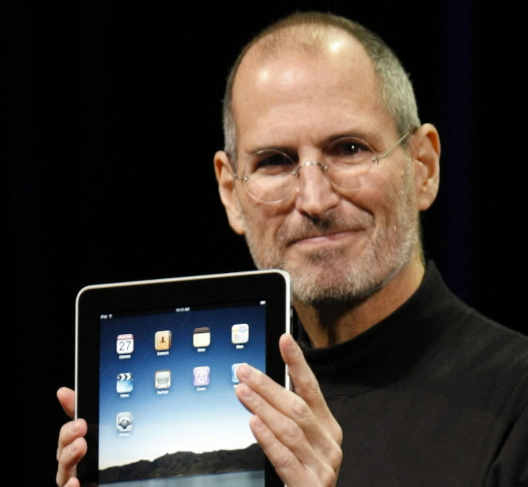
Famous Quotes on Marketing
A reporter who asked Jobs about the market research that went into the iPad was famously told, "None. It's not the consumers’ job to know what they want."
Notes:
This is a bit of mythmaking on Apple’s part. Very likely they do do market research and marketing. But the main point still stands, people don’t always know what they want.

Slide 26
Other Reasons We Can’t Just Ask Users What They Want
Not familiar with what is possible with tech
… with design constraints
Budget, legacy code, time, etc
… with good design
… with security and privacy
Sometimes users don’t know what they want
Ex. Remote controls
People are good at identifying problems they face, but not necessarily solutions
Notes:
Master apprentice in contrast to other kinds of relationships, ex. scientist-observer or parent-child

Slide 27
Major Considerations for UX Design
Organizational & Social Context
Tasks
Design
Technology
Humans
Notes:
Main focus is on people, as opposed to (e.g.) business interests, production costs, etc
Give Examples of Tasks:
high level:
- writing a paper
- drawing a picture
low level:
- copying a word from one paragraph to another
- coloring a line

Slide 28
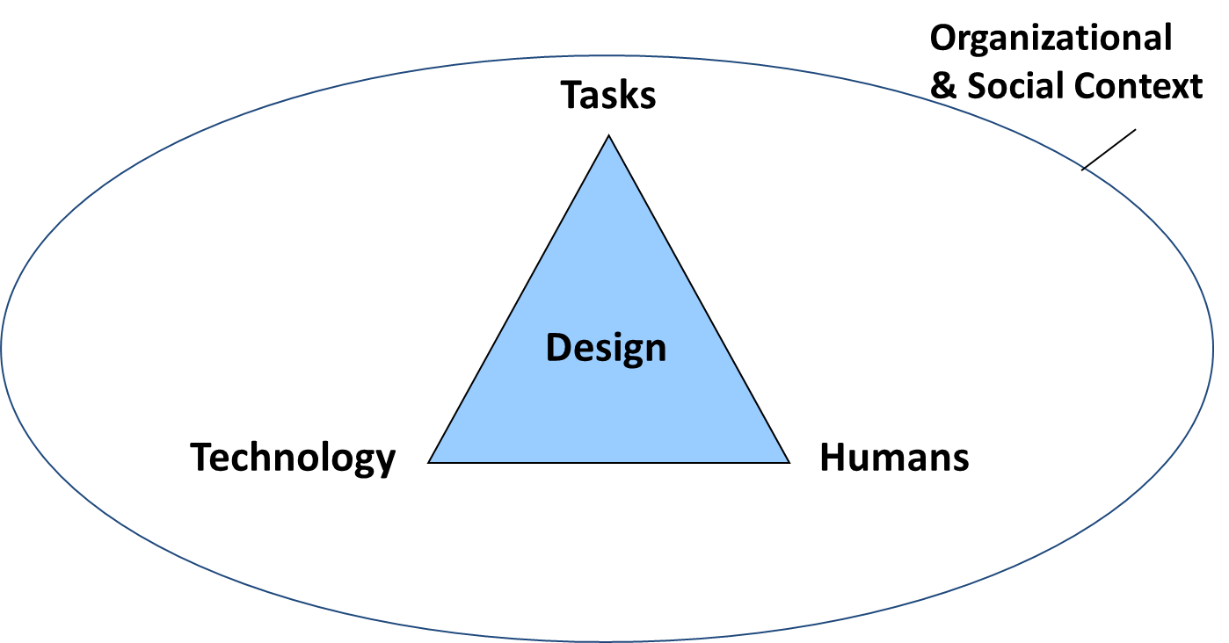
Why Good UX Design is Hard (1/4)
This diagram also useful for probing why good UX design is hard
Tech
Constantly changing
Building and testing software is hard
People
Many considerations, ex. accessibility, education
Need wide range of knowledge and skills to account
Color, layout, design patterns, tools, user testing

Slide 29
Why Good UX Design is Hard (2/4)
Organizational and Social
Cybersecurity constraints
US State Dept was still using MSIE 5 in late 2000s (when MSIE 8 was available!)
Or password length (12+ chars, 2 symbols, etc)
Legal constraints
HIPAA law means doctors can’t send email
Voting machines in one state had to use all caps
Notes:
When I visited State Dept back around 2008, they were still using MSIE 5, I think MSIE 8 was the latest version at the time

Slide 30
Why Good UX Design is Hard (3/4)
Not part of diagram, but implicit is market forces
Standards (style guidelines, related products)
Internationalization
Performance needs
Multiple platforms
Compatibility
Time to develop and test (“time to market”)

Slide 31
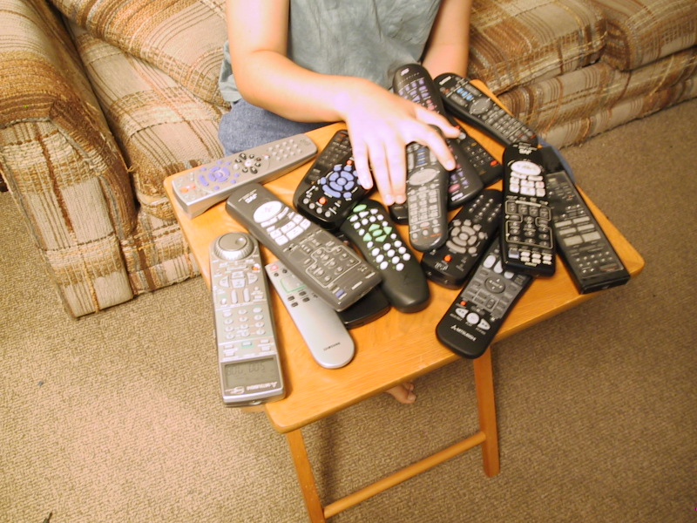
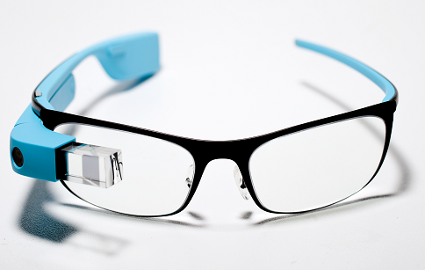
Why Good UX Design is Hard (4/4)
Also not part of diagram is complexity
Your design might be great
But ecosystem might not be
Google Glass example
“Ok Glass, take a picture”
Lots of emergent behaviors hard to predict
Notes:
http://www.cmuchimps.org/uploads/publication/paper/177/toward_a_safe_and_secure_internet_of_things.pdf
A major challenge for IoT is that devices will interact with each other in unexpected and unintended ways, and these emergent behaviors will make it extremely difficult to reason about and manage the security of the entire systems. As a trivial example, a friend told me that a person once annoyed a bunch of people wearing Google Glass by shouting out “Ok Glass, take a picture,” causing everyone’s wearable to take a picture.

Slide 32
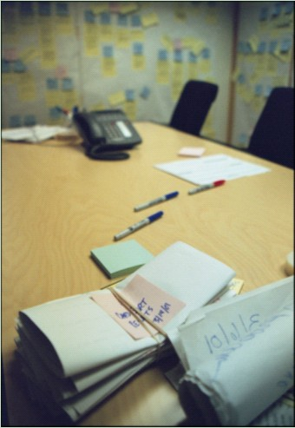
Who Builds User Interfaces?
A team of specialists (ideally)
Graphic designers
UX designers
Technical writers
Marketers
Test engineers
Usability engineers
Software engineers
Product managers
Users
Notes:
In this course you will wear the hats of many of these specialists.
It’s hard for a single person to have the range of needed skills

Slide 33
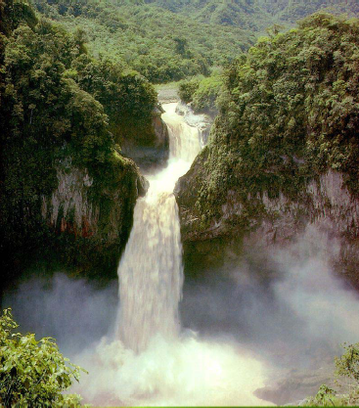
What Processes are there for Building Applications?
One fairly typical process: waterfall
Requirements
Specification
Design
Coding
Integration
and Testing
Operation
and Maintenance

Slide 34
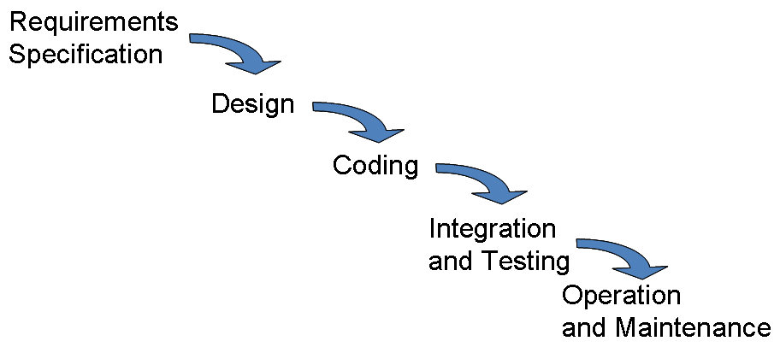
What Processes are there for Building Applications?
“Waterfall” because when you finish one phase you are not supposed to go back “up stream”
Thoughts?

Slide 35
Problems with Waterfall Approach
Implies that you design once (and get it right the first time)
Unlikely in practice (see Nintendo Wii example)
Can’t easily go back up if problem downstream
Design may be unrealistic / infeasible
You’re stuck, can’t easily adapt if you find problems
Slow to learn what should be built
Historically, did not get feedback from users
Tend to only get feedback after building the software

Slide 36
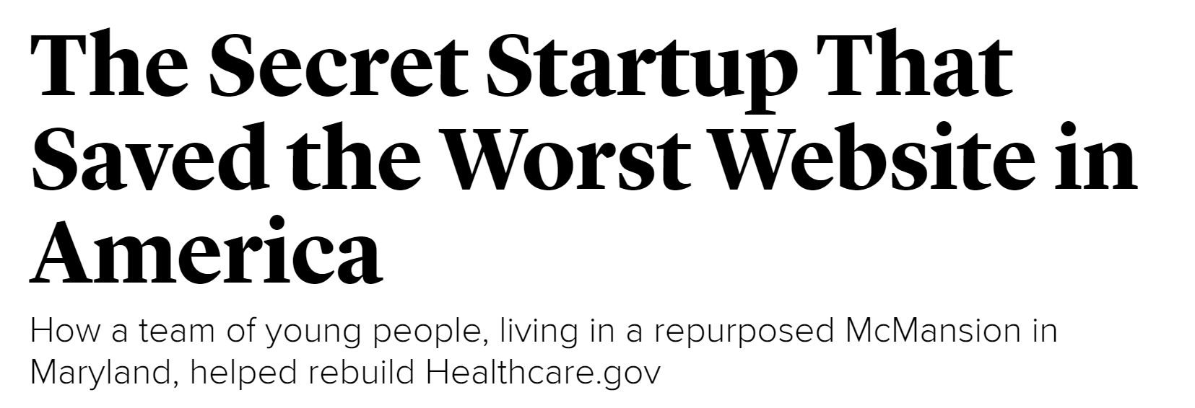
The Atlantic, July 9 2015
http://www.theatlantic.com/technology/archive/2015/07/the-secret-startup-saved-healthcare-gov-the-worst-website-in-america/397784/

Slide 37
The Secret Startup That Saved the Worst Website in America
The government’s method of running software turned on a sequential design strategy known as “the waterfall”: a central calendar, the Gantt chart to end all Gantt charts, that promulgated when every task would finish. The government tried running software development as a bureaucratic process, with project managers managing project managers, and the whole thing broke.

Slide 38
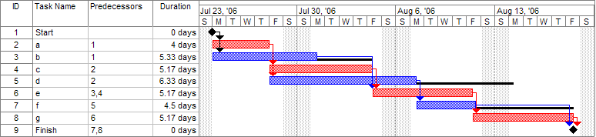
Tangent: Gantt Chart
Used for scheduling tasks and dependencies

Slide 39
Problems with Waterfall Approach
So while waterfall not typically advocated anymore, terminology and biases remain
Ex. “We’ll fix the user interface at the end”
Ex. Do testing all at once after building the entire thing (rather than progressively as you go)
Note that “testing” for software engineers different than for UX practitioners
Software quality testing vs user testing
Notes:
The first time the team and the government tried to implement them together, government representatives drew up a plan for a three-month plan, complete with five carefully scheduled development sprints.

Slide 40

Alternative: Iterative Design
Short cycles of design, prototype, evaluate
Quickly validate assumptions
Fail fast
Progressive refinement
Generally, the more cycles you can do, the better the design
Links in well with agile methods
Short sprints, get lots of feedback
More on this next class
Design
Prototype
Evaluate
Notes:
Don’t have a lot of hard constraints as in other areas of engineering
Iterative Design works really well
Generally, more cycles you go thru, the better

Slide 41
Administrivia
Reminder: No laptops in class
HW0 and HW1 due Friday @ 11:59pm
Submit on Canvas, or to TA in section if (by Friday) still on waitlist
Get and read book Design of Everyday Things
Start tutorials on HTML / CSS if not familiar
Tepper Quad availability
Update this slide for each semester

Slide 42
Administrivia
Entrepreneurship Boot Camp, Sat Sep 8 (free)
Overview of entrepreneurial support programs at CMU and in Pittsburgh
https://t.e2ma.net/click/peg06/xgr0ug/529bgq
Product Camp Pittsburgh, Sat Sep 22 (free)
Product Management
https://www.pghpcamp.com/
No class on Monday, Labor Day
Make up lab Wed 10:30am NSH3305 (Sections A + B)
Sections C + D, go to your regular lab
Update this slide for each semester

Slide 43
Administrivia Waitlist
Admit
Cameron Burgess
Fengyi Zhang
Dean Digour
Yim Yellina
Tiffany Liu
Nupur Maheshwari
William Goldby
Victoria Feng
Note
Most of folks on left side are overloaded
Need to fix asap or we can’t add you
For others on waitlist
Small chance of getting into class, submit HW0 and HW1 if still want to try
Update this slide for each semester

Slide 44
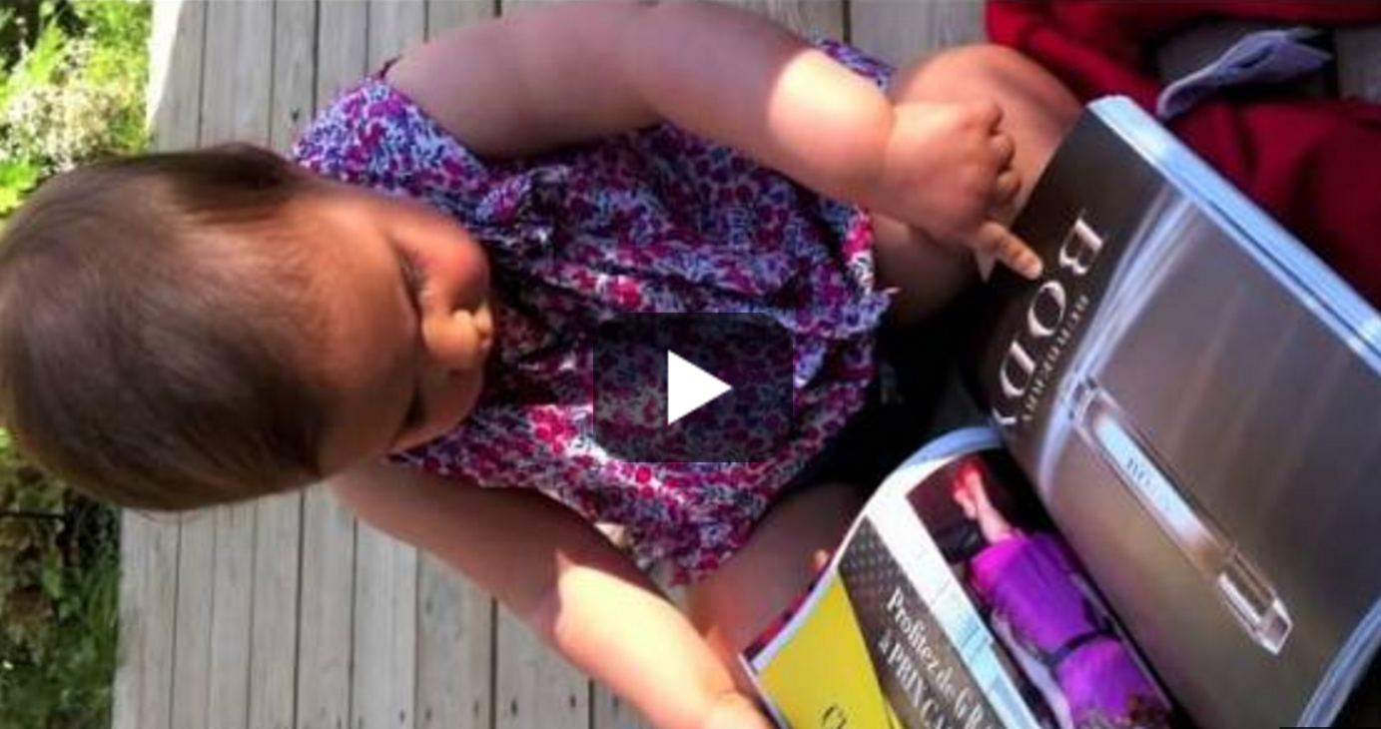
One Minute Break
A Magazine is an iPad that Doesn’t Work
https://www.youtube.com/watch?v=aXV-yaFmQNk

Slide 45
Outline for Today
What is Design?
Myths about Design
Why is Good Design so hard?
Processes
Usability Goals and Metrics
Mindset for Good Design

Slide 46
Design
Design is driven by requirements
Focus on core needs, not how implemented, since may be multiple ways of achieving goals
Ex. Android phone not as important as “mobile” app
A design is a simplified representation of the desired artifact
Ex. text description of tasks
Ex. screen sketches or storyboards
Ex. flow diagrams / task structure
Ex. interactive prototypes
Can share with team
Write essay
start word processor
write outline
fill out outline
Start word processor
find word processor icon
double click on icon
Write outline
write down high-level ideas
.
.
.

Slide 47
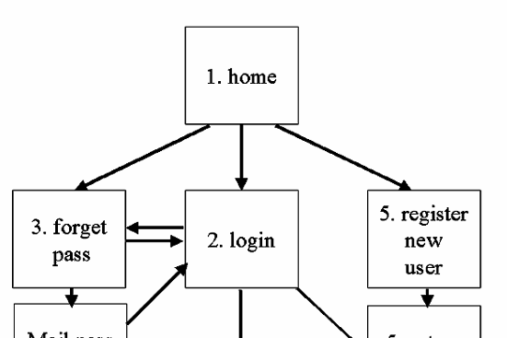
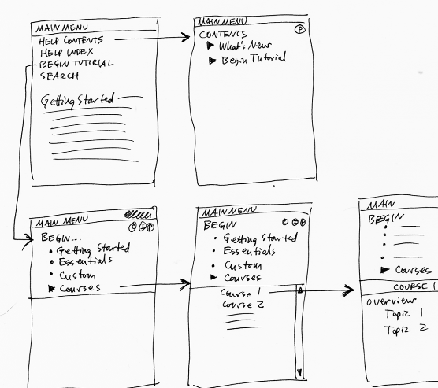
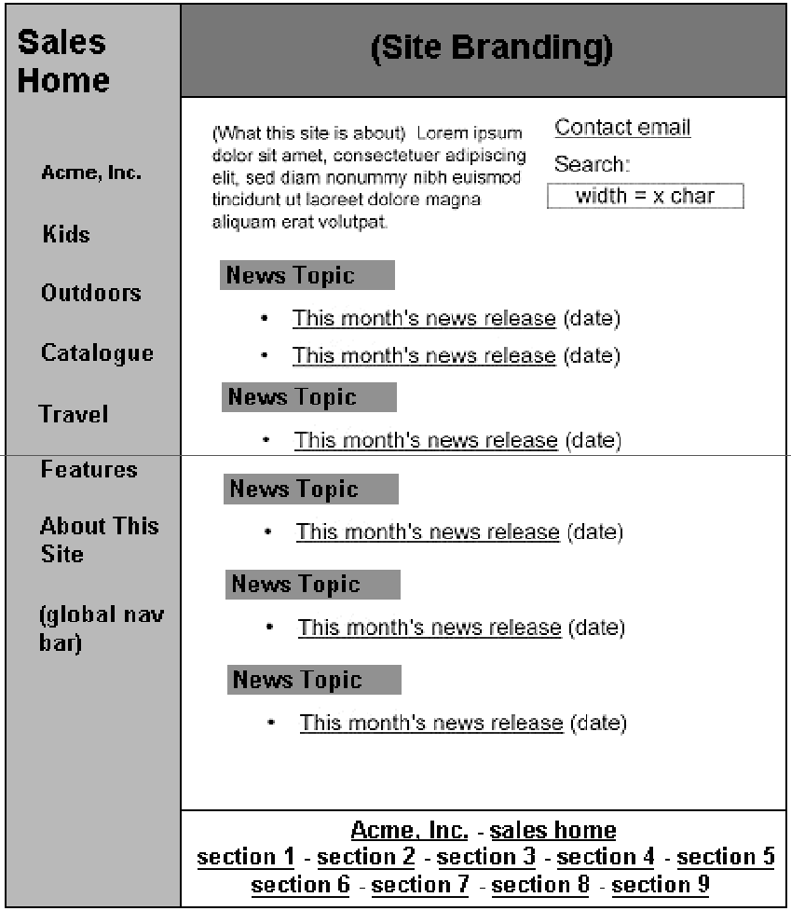

Design Representations
Site Maps
Storyboards
Schematics
Mock-ups
Notes:
Designers create representations of sites at multiple levels of detail
Web designs are iteratively refined at all levels of detail
Will talk more about this in next class on prototyping, giving you a preview of how things fit together

Slide 48

Usability Goals
Want to make sure we make progress in UX
Can do this by setting and measuring goals
According to the ISO:
The effectiveness, efficiency, and satisfaction with which specified users achieve specified goals in particular environments
This does not mean you have to create boring designs or only for novices
It all depends on your goals

Slide 49
Example Usability Goals?
Clear this slide
Time on task
Able to accomplish tasks
Stuck or not (critical incidents)
Want to use later
Accuracy / context specific
Replicable / do the tasks consistently
Learnable
Explain to others
Notes:
Looks cool
Does what it was supposed to do
Less Time
Easy to learn
Simple / no training
Low cognitive load
Responsive
Easy to understand flow
Intuitive
Error tolerance
Easy to remember over time how to use
Flexibility
Feels good to use
Easy to maintain
Consistent / internally externally
Battery life / energy
Affordable
Good docs
Predictable
Durable / non-obsolescent
Fewer bug reports / complaints on forums
Depth / expertise
High performance by experts (bikes vs tricycles)
Easy adoption / out of box experience
Stickiness / DAU MAU
No distractions / focus well
Error prevention / errors
Teach each other / #messages support board
Efficiency of use
Enjoyable
Discoverability
Accessibility
User stress / keystrokes
Money / #helpdesk calls / conversion
Better than competition / operationalize

Slide 50
Some Example Usability Goals (1/2)
Learnable
Faster the 2nd time and so on
Memorable
From session to session
Flexible
Multiple ways to accomplish tasks
Efficient
Perform tasks quickly
Pleasing
High subjective satisfaction

Slide 51
Some Example Usability Goals (2/2)
Robust
Minimal error rates
Good feedback so user can recover
Out of box experience
First time to “oh that’s cool” or being productive
Fun
Again, note that usability goals depend on what you’re trying to accomplish

Slide 52
How might you measure these example usability goals?
Learnability
Memorability
Flexibility
Efficiency
Robustness
Pleasing
Out of box experience
Fun

Slide 53
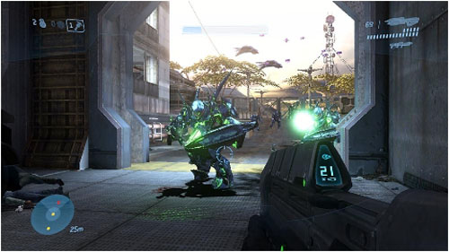
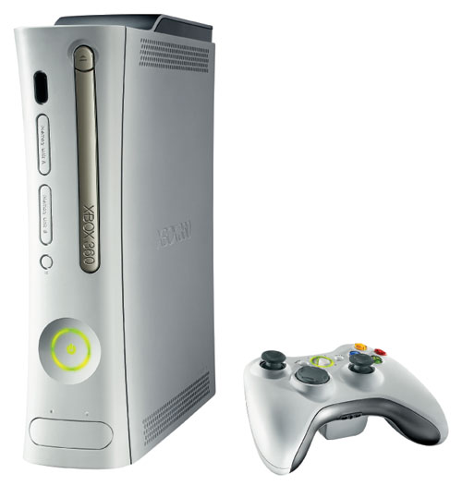
Case Study: Game Testing for Fun in Halo 3
http://www.wired.com/gaming/virtualworlds/magazine/15-09/ff_halo
Notes:
http://www.wired.com/gaming/virtualworlds/magazine/15-09/ff_halo

Slide 54
Case Study: Game Testing for Fun in Halo 3
After each session Pagulayan analyzes [log] data for patterns...
For example, he produces snapshots of where players are located in the game at various points in time — five minutes in, one hour in, eight hours in — to show how they are advancing.
If they're going too fast, the game might be too easy; too slow, and it might be too hard.

Slide 55
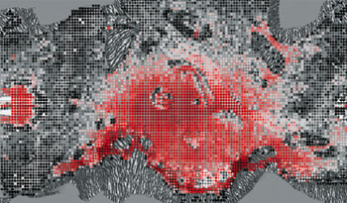
Case Study: Game Testing for Fun in Halo 3
He can also generate a map showing where people are dying, to identify any topographical features that might be making a battle onerous. And he can produce charts that detail how players died

Slide 56
Case Study: Game Testing for Fun in Halo 3
A similar report showed that in the game's first level… players often ran out of rounds for their rifles.
This was a mystery, because the designers had been careful to leave more than enough ammunition lying around.
The team checked Pagulayan's video records and found that people were firing at the aliens when they were too far away, misjudging the range of the weapon and wasting bullets.

Slide 57
Case Study: Game Testing for Fun in Halo 3
At first the designers couldn't figure out how to fix this problem. But then Griesemer stumbled on an elegant hack: He made the targeting reticule turn red when enemies were in range, subtly communicating to players when their shots were likely to hit home. It worked.
Last week 52 percent of players gave the Jungle level a 5 out of 5 rating for "fun," and another 40 percent rated it a 4.

Slide 58
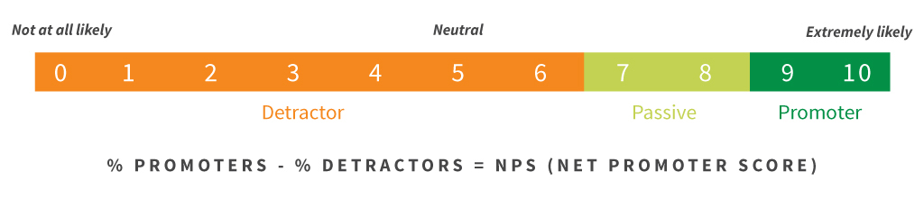
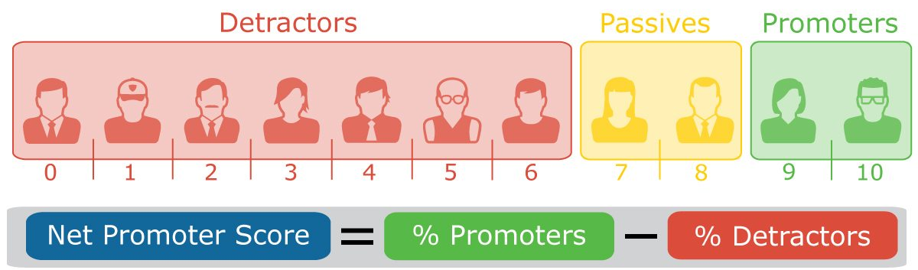
NetPromoter
Not common in HCI, popular among executives
Can benchmark your product vs others
Note: costs money to compare
Example scores (2013)
Costco 78%
Apple – Laptop 76%
Dillards 75%
Nordstrom 75%
Apple - iphone 70%
Amazon 69%
Southwest Airlines 66%
Apple – ipad 65%
Notes:
https://www.netpromoter.com/know/
http://www.insightsfromanalytics.com/blog/bid/324678/Top-10-U-S-Net-Promoter-Scores-NPS-for-2013
USAA - Insurance = 80%
USAA - Banking = 78%
Costco = 78%
Apple - Laptop = 76%
Dillards = 75%
Nordstrom = 75%
Apple - iphone = 70%
Amazon = 69%
Southwest Airlines = 66%
Apple - ipad = 65%

Slide 59
Outline for Today
What is Design?
Myths about Design
Why is Good Design so hard?
Processes
Usability Goals and Metrics
Mindset for Good Design

Slide 60
You are Not the User
Most important takeaway for today is to understand “you are not the user”
Easy to think of self as typical user
Easy to make mistaken assumptions
One of the greatest UX skills is empathy
Understanding another person’s point of view
Appreciating the problems people face
Sympathizing with their pain points
Notes:
You already know too much
Easy to think of self as typical user
Easy to make mistaken assumptions
This is the most common mistake possible

Slide 61
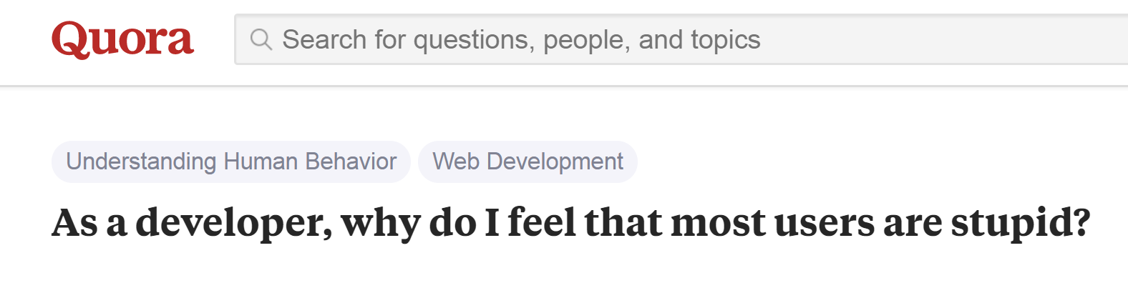
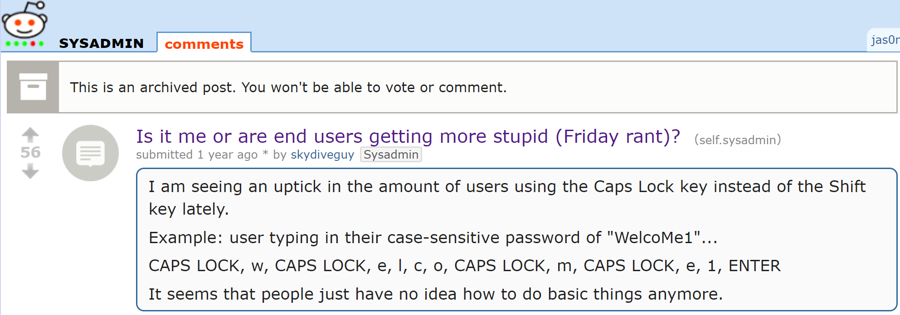
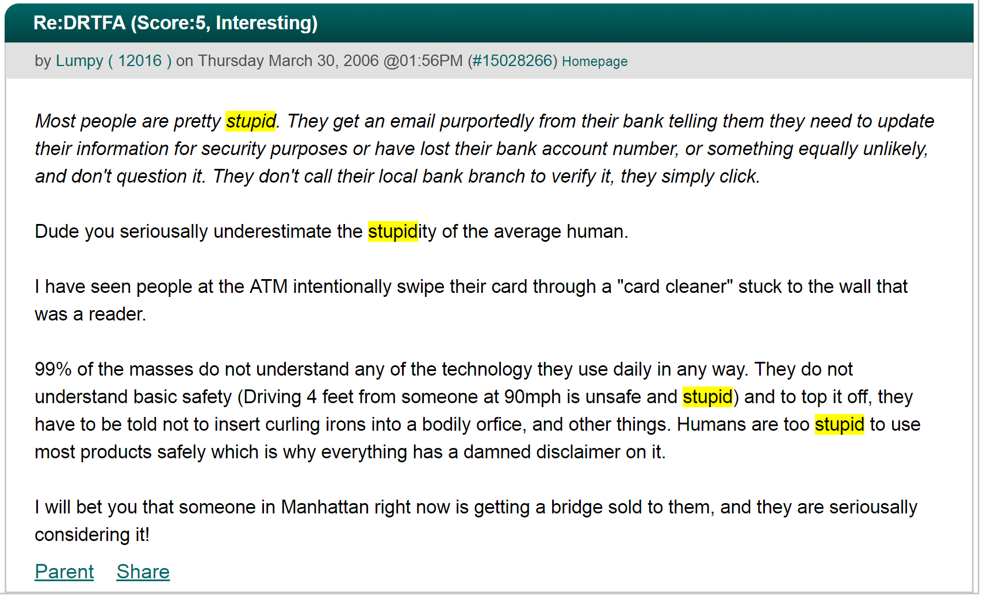
You are Not the User
Notes:
You already know too much
Easy to think of self as typical user
Easy to make mistaken assumptions
This is the most common mistake possible

Slide 62
Phil Agre’s “How to Help Someone Use a Computer”
Nobody is born knowing this stuff
You've forgotten what it's like to be a beginner
If it's not obvious to them, it's not obvious
A computer is a means to an end. The person you're helping probably cares mostly about the end.
Beginners face a language problem
Most UIs are terrible. When people make mistakes it's usually the fault of the interface. You've forgotten how many ways you've learned to adapt to bad interfaces.
Notes:
http://polaris.gseis.ucla.edu/pagre/how-to-help.html

Slide 63
Task Analysis
So how can we start understanding users?
Task Analysis
Set of questions to understand users and context
Help you realize what you do and don’t know
Gives you a focus for other methods, and assumptions to quickly validate

Slide 64
Example Task Analysis Questions
Note: there is no canonical set of Task Analysis questions, these are just examples
Who is going to use the system?
What tasks do they now perform?
What tasks are desired?
How are the tasks learned?
Where are the tasks performed?
What’s the relationship between user & data?

Slide 65
Example Task Analysis Questions
What other tools does the user have?
How do users communicate with each other?
How often are the tasks performed?
What are the time constraints on the tasks?
What happens when things go wrong?
Let’s go through a few of these…

Slide 66
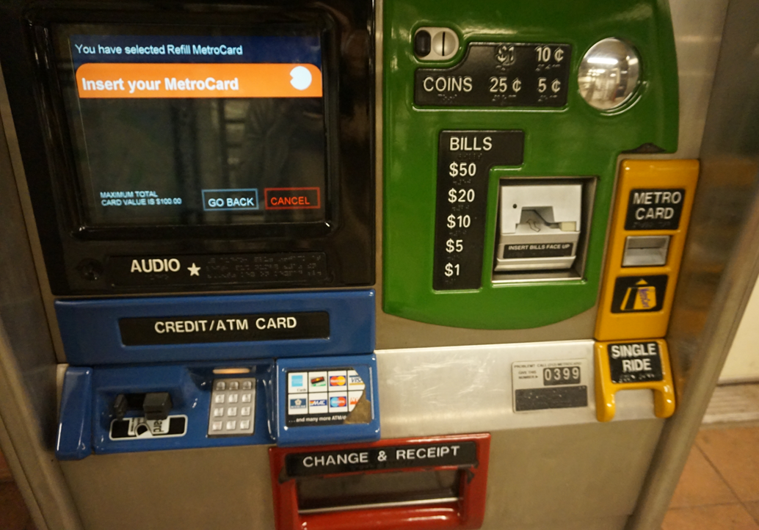
Notes:
Ok let’s use ticket machine as an example
This is one from NYC

Slide 67
Who?
Identity
In-house or specific customer is easy
Need several prototypical users for broad product
Background
Skills
Work habits and preferences
Physical characteristics
Notes:
Give example from past capstones: NASA Astronauts, medical staff, electrician, people who travel

Slide 68
Who Uses Ticket Machines?
Identity?
Business people, students, disabilities, elderly, tourists
Background?
May have an ATM or credit card
Have used other fare machines before
Skills?
Probably knows how to put cards into ATM
English ranges from rudimentary to native speaker

Slide 69
Who Uses Ticket Machines?
Work habits and preferences?
Some people use subway 5 days a week
Others are first time use (tourists)
Physical characteristics?
Varying heights −> don’t make it too high or too low

Slide 70
What Tasks?
Important for automation and new functionality
Understand relative importance of tasks and make those shorter / easier (vs rare tasks)
“Simple things should be simple, complex things should be possible” – Alan Kay
Example tasks
Figure out destination
Buy one or more tickets (this failed for me in NYC)
Refill existing card
Notes:
small dentists office installed new billing system
assistants became unhappy with new system
old forms contained hand-written margin notes
e.g., patient A’s insurance takes longer than most

Slide 71
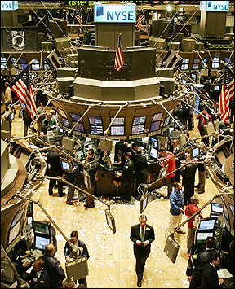
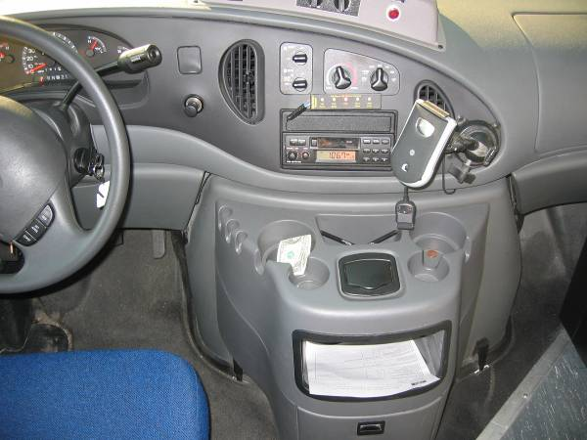
Where is the Task Performed?
Office, laboratory, point of sale?
Effects of environment on users?
Users under stress?
Confidentiality required?
Wet, dirty, or slippery hands?
Soft drinks?
Lighting?
Noise?

Slide 72
Relationship Between Users & Data?
Public data?
Open government records, public web sites
Personal data?
Ex. health records, bank records
Always accessed at same machine?
Do users move between machines?
Common data?
Used concurrently?
Passed sequentially between users?
Remote access required?
Access to data restricted?

Slide 73
Other Tools Users Have?
More than just compatibility
How user works with set of tools to get things done
Examples:
Subway maps
Person behind counter
Personal maps (maybe)
Smartphones
Notes:
how is data collected now?
by what instruments and manual procedures?
how is the information analyzed?
are the results transcribed for records or publication?
what media/forms are used and how are they handled?

Slide 74
How Often Users Perform the Tasks?
Frequent users may remember more details
Infrequent users may need more help
Even for simple operations
Make these tasks possible to do
Ex. Wizard-based UIs good for rare tasks
Which function is performed:
Most frequently?
By which users?
Optimizing system for these tasks will improve perception of good performance

Slide 75
Use Variety of Methods to Answer Task Analysis Questions
Initial task analysis can be done at start of project
However, task analysis just a starting point
Need to validate your answers
And then iterate
How do we do this?
Triangulate with multiple methods
Ex. Observe prospective users in natural settings
Ex. Interviews
Take UCRE class for more methods
Design
Prototype
Evaluate

Slide 76
Design From Data
Heated arguments with others on design team
What tools, skills, and knowledge do users have?
Should it be this feature? This layout?
These tend to generate lots of heat, little light
Go to real users and get data
Find out what they really do
Or test early prototypes
Are they too busy?
Buy their time (t-shirts, coffee mugs)
Find substitutes (e.g. medical students)
Notes:
Master apprentice in contrast to other kinds of relationships, ex. scientist-observer or parent-child
Notes for next time
Tufte – think really hard and design
You can’t user test your way to a good design (see Google+)

Slide 77
Selecting Tasks
Given task analysis, choose real tasks users face
Use these for usability tests and to drive your design
Have mixture of simple and complex tasks
Easy tasks (e.g. login or create account)
Moderate tasks
Difficult tasks (infrequent or for power users)
Good tasks fundamental to good usability
Does your system support key tasks desired by users?
How well does your system support these?

Slide 78
Using Tasks in Design
Write up a description of tasks (informal ok)
Tells a cohesive and plausible story
Run by users and rest of the design team
Do they make sense?
Can hand task to users on an index card
Note task descriptions focus on what, not how
Manny is in the city at a club and would like to call his girlfriend, Sherry, to see when she will be arriving at the club. She called from a friend’s house while he was driving, so he couldn’t answer the phone. He would like to check his missed calls and find the number so that he can call her back.

Slide 79
Taking a Step Back
Most important concepts today
You are not the user
Empathy important attribute for good UX design
Iterative Design, fail fast (more next lecture)
Validate your assumptions quickly
Many ways of measuring usability (depends on goals)
Design from Data

Slide 80
Action Items
HW0 and HW1 due Friday @ 11:59pm
Submit on Canvas, mail TA if still on waitlist
Get and read book Design of Everyday Things
Start tutorials on HTML / CSS if not familiar
Do readings for next class (2 short papers)
Prototyping for tiny fingers
Some Techniques for Observing Users
No class Monday
Make up lab Wed 10:30am NSH3305 (Sections A + B)
Sections C + D, go to your regular lab

Slide 82
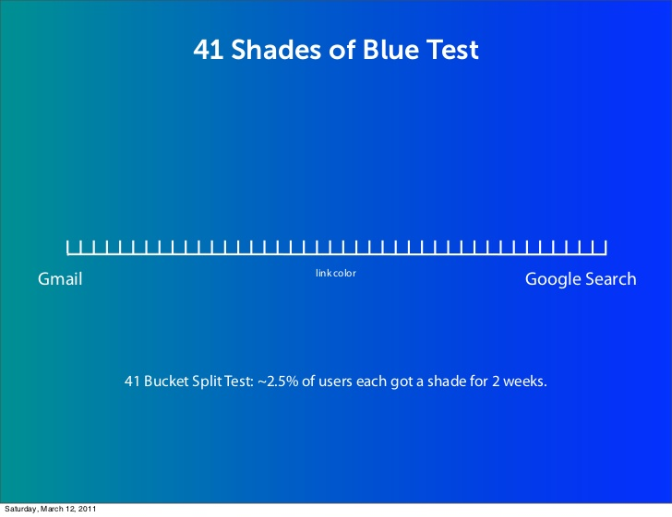
Google Testing 41 Shades of Blue
“Google's engineers apparently couldn't decide on two shades of blue for showing search results, so they tested 41 of them to see which attracted the most clicks. ” - FastCoDesign
Notes:
From http://www.slideshare.net/andrew_null/metrics-driven-design-by-joshua-porter/9-Doug_Bowman_on_Design_at
https://www.fastcodesign.com/1662273/google-equates-design-with-endless-testing-theyre-wrong

Slide 83
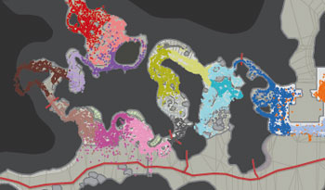
Where People Get Lost in Halo
Notes:
Welcome to the Jungle In early tests, players wandered lost around the Jungle level: Colored dots showing player location at five-second intervals (each color is a new time stamp) were scattered randomly. So Bungie fixed the terrain to keep players from backtracking. Sure enough, the dots clustered by color, showing that players were moving smoothly through the map.

